Slide 1
React Bootstrap
Using React Bootstrap | Forms | Modals | Other Components
Notes:
Welcome to our lecture on react bootstrap. In this lecture we will go through how to use bootstrap in react, forms in react, modals, and other components. Let’s start the video lecture.

Slide 2

React Bootstrap
React Bootstrap is a third-party library offering React components for building a React app's user interface.
It uses Bootstrap for styling, ensuring responsive and consistent designs.
Install React Bootstrap using npm with the command: npm install react-bootstrap.
Notes:
React Bootstrap is a third-party library that provides React components for building a user interface in React apps. It uses Bootstrap for styling, ensuring responsive and consistent designs. To install React Bootstrap, use npm with the command: npm install react-bootstrap. This makes it easy to integrate Bootstrap's design system into React projects.

Slide 3
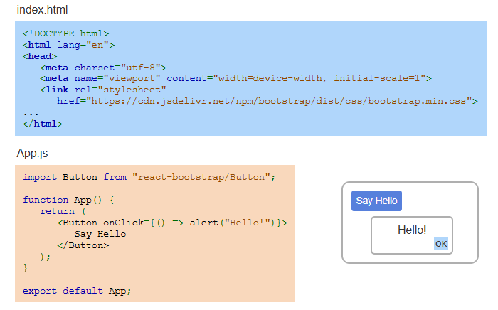
Example
Notes:
In index dot html, we link the Bootstrap stylesheet using a CDN. In App.js, we import the Button component from React Bootstrap. The button has an onClick event that triggers an alert saying Hello. This shows how easily React Bootstrap components can be used to create interactive and styled user interfaces.

Slide 4
Forms
React Bootstrap's Form component creates forms with Bootstrap styling.
Key child components:
FormControl: Textbox, text area, color picker, and other inputs.
FormCheck: Checkbox or radio button.
FormRange: Range input.
FormLabel: Label for FormControl.
FormGroup: Wraps FormControl and FormLabel with help text and validation.
Notes:
Let's explore forms in React Bootstrap. The Form component allows you to create forms with Bootstrap styling. Key child components include Form Control for text inputs, Form Check for checkboxes or radio buttons, Form Range for range inputs, Form Label for labeling inputs, and Form Group to wrap Form Control and Form Label with help text and validation.

Slide 5
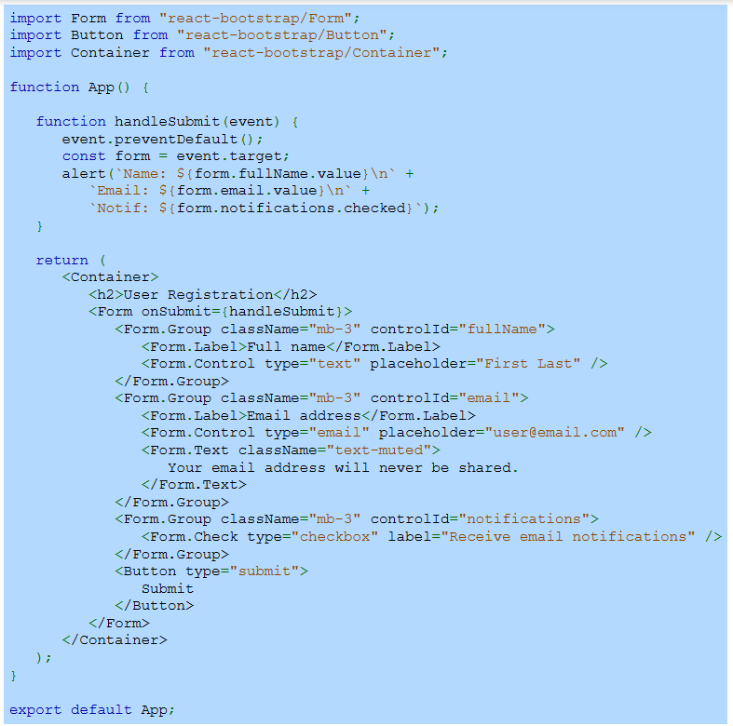
Example
Notes:
In this example of a form using React Bootstrap, we import Form, Button, and Container components. The form includes inputs for full name, email, and a checkbox for notifications. It uses Form Group, Form Label, and Form Control for styling. On submit, the handle Submit function displays the form data in an alert. This demonstrates creating a responsive and styled form.

Slide 6
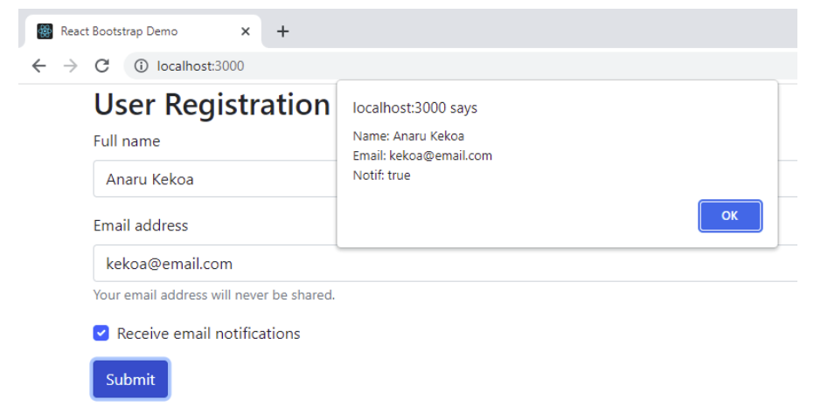
Example (Continue)
Notes:
Here is the result of the React Bootstrap form example. When the user fills in their name, email, and selects the checkbox, clicking Submit triggers an alert showing the input data. This demonstrates how React Bootstrap provides a clean and responsive design while maintaining interactive functionality, making form handling easier and more efficient.

Slide 7
Modal
React Bootstrap's Modal component displays a dialog box over the page.
It typically includes buttons for choosing options and closing the dialog.
In the example, clicking the Button shows the Modal, and selecting Yes or No closes it.
Notes:
React Bootstrap's Modal component displays a dialog box over the page. It is commonly used for alerts, confirmations, or additional details. The Modal usually includes buttons for choosing options or closing the dialog. In the example, clicking the Button shows the Modal, and selecting Yes or No closes it. This adds interactivity while maintaining a clean design.

Slide 8
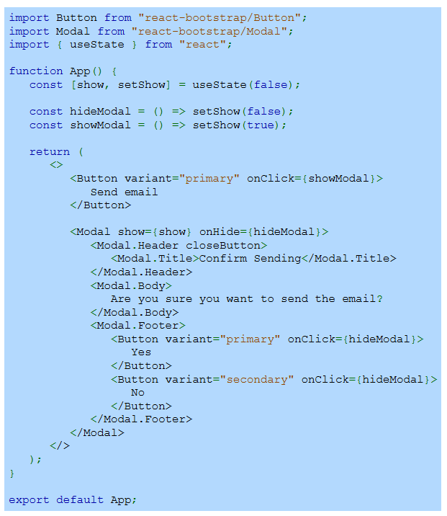
Example
Notes:
This example shows how to use React Bootstrap's Modal component. The Button triggers the Modal to appear by updating the show state with useState. The Modal includes a title, body text, and two buttons labeled Yes and No. Clicking either button hides the Modal by calling the hideModal function. This example demonstrates how to create interactive and dynamic dialogs in React.

Slide 9
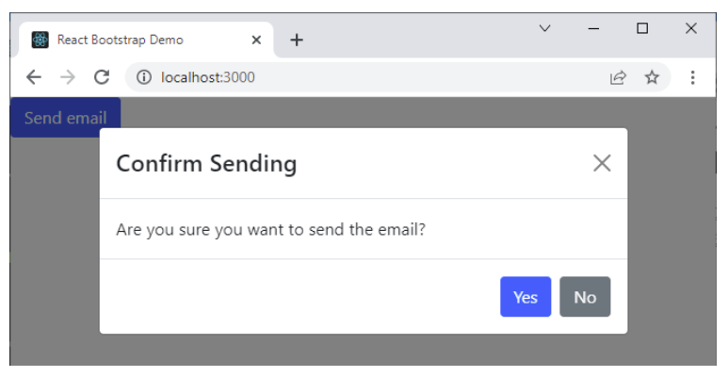
Example (Continue)
Notes:
This is the result of the React Bootstrap Modal example. Clicking the Send Email button triggers the Modal to appear. The Modal displays a confirmation message with Yes and No buttons. Selecting either option closes the Modal. This shows how React Bootstrap's Modal component creates a clean and interactive dialog box for user confirmations.

Slide 10
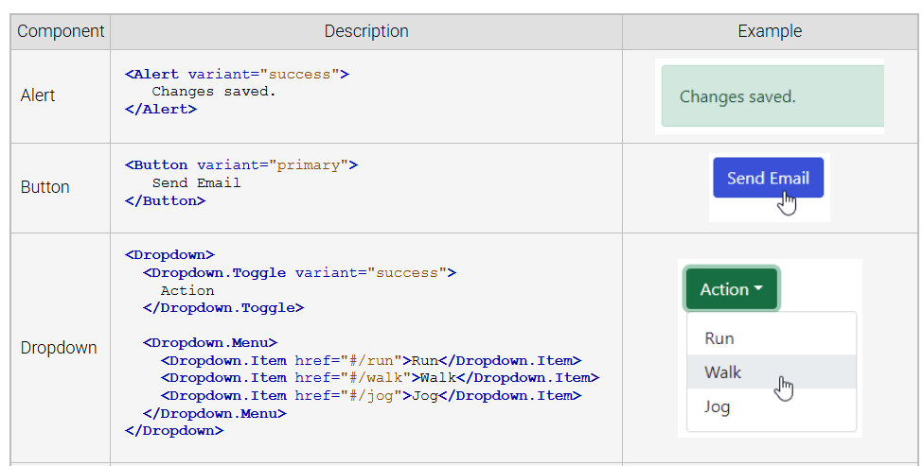
Other Components
Notes:
React Bootstrap offers various components for building interactive UIs. Alert displays messages like success notifications. Button provides styled clickable elements. Dropdown creates a menu with multiple options. These components maintain consistent styling and functionality, enhancing user experiences while simplifying the development process.

Slide 11
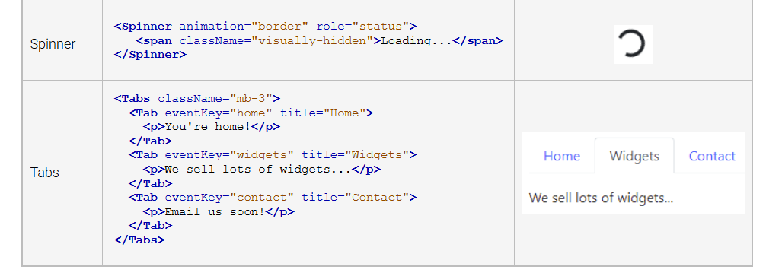
Other Components
Notes:
React Bootstrap provides more components for dynamic interfaces. Spinner shows loading states with animated indicators, enhancing user feedback. Tabs organize content into navigable sections, improving layout and usability. These components maintain consistent styling, helping developers create responsive and user-friendly applications efficiently.

